Slide 1
EMC InfoArchive 101
Getting Control of Exploding Information

Slide 2
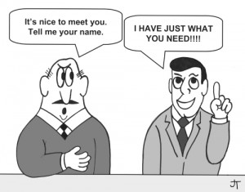
What You Will Learn
About this course
After completing this course you will be able to…
Understand EMC InfoArchive
Discover and qualify sales opportunities
Articulate the InfoArchive value proposition
Handle competitive situations
Get information to help you sell

Slide 3
S a l e s T r a i n i n g
MARKET OVERVIEW
This Section Will Cover:
Market Situation
Customer Challenges

Slide 4
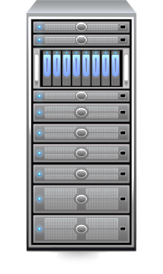




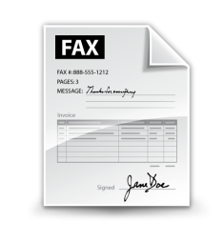

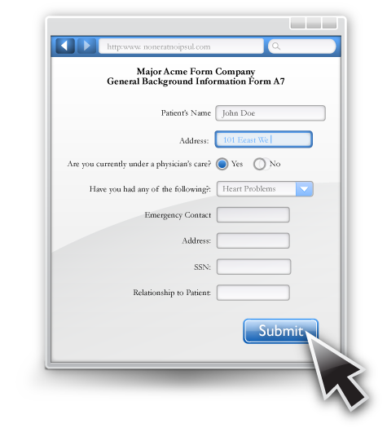

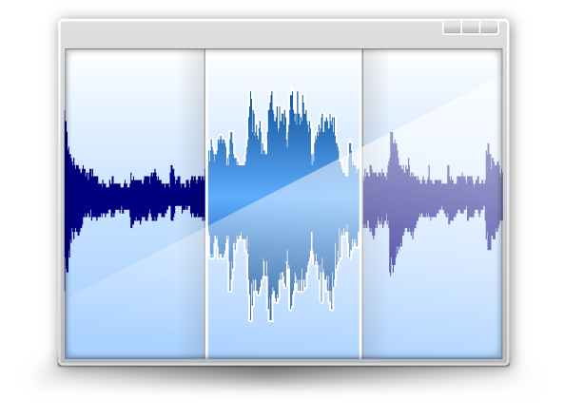





The Market Situation: Information Overload
APPLICATIONS
USERS
Business Applications generate vast amounts of information
Market Overview
Product Description
Identify Opportunities
Qualify Opportunities
Competitive Differentiators
Position the EMC Solution
Proof Points
Additional Resources

Slide 5
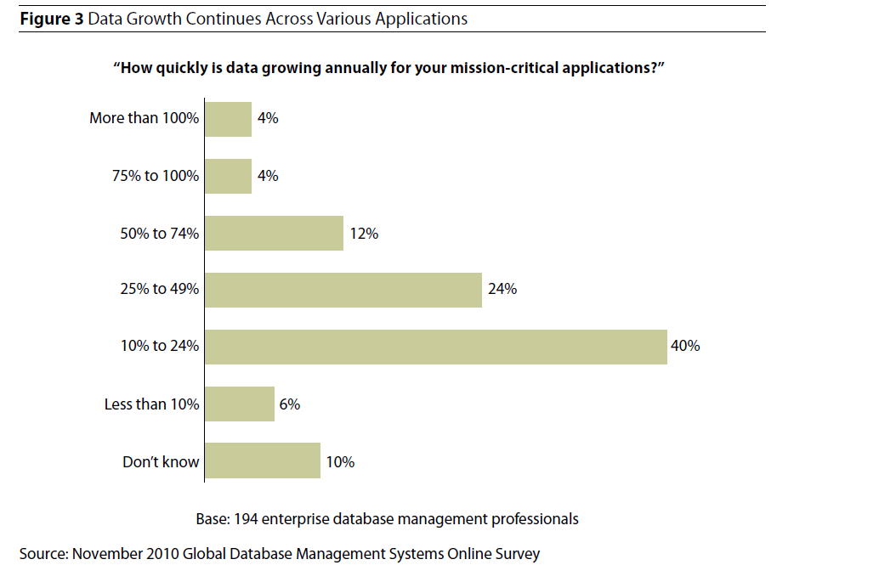
The Market Situation: Information Overload
APPLICATIONS
USERS
Business Applications generate vast amounts of information
Market Overview
Product Description
Identify Opportunities
Qualify Opportunities
Competitive Differentiators
Position the EMC Solution
Proof Points
Additional Resources

Slide 6
A Typical Example
Market Overview
One EMC customer has 60 applications that together generate:
10 million data records per day
2 million documents per day
Product Description
Identify Opportunities
While this information is active – while it is still in process– it
must be kept in the operational system that created it
But keeping it in the operational system after the information has become stable is unnecessary
Qualify Opportunities
Competitive Differentiators
Position the EMC Solution
Proof Points
Additional Resources

Slide 7
The Market Situation: Information Overload
Market Overview
This explosive growth can affect performance and drive up costs for IT – both operational and capital expenses
According to Gartner, 60-80% of data in operational applications is inactive – not changing
So why not archive it?
What’s needed is an archiving solution that
Improves application performance
Reduces IT costs
Meets compliance requirements
Provides access to the data as needed
Product Description
Identify Opportunities
Qualify Opportunities
Competitive Differentiators
Position the EMC Solution
Proof Points
Additional Resources

Slide 8
Challenge 1: IT Costs
Market Overview
Ever-increasing volumes of application data lead to three types of costs
Server costs
Including the initial cost and annual maintenance of the DBMS software
Storage Costs
Including costs of electricity, air conditioning, and data-center real estate
Operational Costs
Backups, recovery, upgrades, tuning
Including costs for maintenance and administration of servers, DBMS and storage
Product Description
Identify Opportunities
Qualify Opportunities
Competitive Differentiators
Position the EMC Solution
Proof Points
Additional Resources

Slide 9
Challenge 2: Compliance
Market Overview
Government regulations impose strict rules on how companies manage application information
The primary regulations are these four:
Product Description
Identify Opportunities
Retention – information must be preserved for a specified period of time
Immutability – information cannot be deleted or changed
Privacy – Sensitive information must be encrypted or masked
Audit Trail – Significant events must be tracked and available for inspection by auditors
Failure to comply with these regulations can mean stiff fines or even time in jail
Qualify Opportunities
Competitive Differentiators
Position the EMC Solution
Proof Points
Additional Resources

Slide 10
Challenge 3: Application Decommissioning
Market Overview
Many businesses are maintaining old, obsolete systems
They do this is strictly for their data, for business reasons or for compliance
It comes at great cost, which IT desperately wants to cut
And with risks, as there may be few IT people with the required expertise
Product Description
Identify Opportunities
Qualify Opportunities
Competitive Differentiators
Position the EMC Solution
Proof Points
Additional Resources

Slide 11
S a l e s T r a i n i n g
PRODUCT DESCRIPTION
This Section Will Cover:
Product Description
Customer Challenges
How EMC Addresses the Challenges

Slide 12

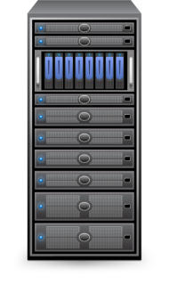




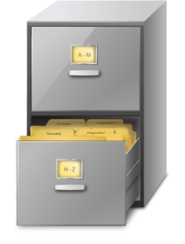
EMC InfoArchive
Market Overview
A holistic, flexible approach that enables organizations to archive applications data with low cost and low risk
Product Description
Identify Opportunities
APPLICATIONS
USERS
Qualify Opportunities
Competitive Differentiators
Position the EMC Solution
Proof Points
TRANSACTIONAL
STATEMENTS
CONTRACTS
DECOMMISSIONED
LEGACY
LINE OF BUSINESS
CUSTOMERS
COMPLIANCE
AUDITOR
CSR
Additional Resources

Slide 13
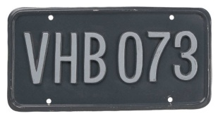
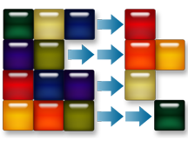
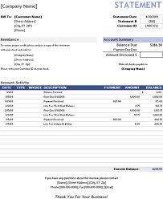
The Unified Archive
Market Overview
InfoArchive archives multiple types of information from many applications
All these forms of information are ingested in the same way
Because of InfoArchive’s unique architecture, large volumes of information can be ingested at very high speeds
Documents -Unstructured Content
Product Description
Identify Opportunities
Structured Data
Qualify Opportunities
Competitive Differentiators
XML Documents
Position the EMC Solution
Proof Points
Print Streams
Additional Resources
Notes:
InfoArchive archives multiple types of information from many applications. This is unstructured content and structured data.

Slide 14
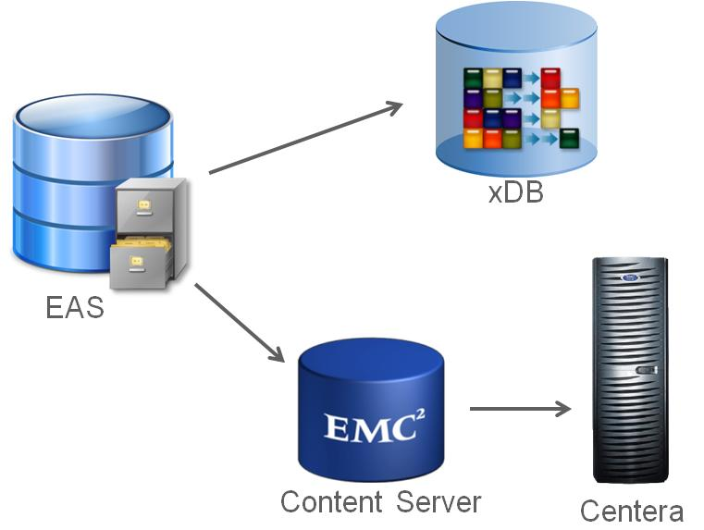
Technology Components
Market Overview
The solution is built upon proven EMC technology, consisting of the following components
The solution can be delivered on premises or virtualized in a Private Cloud
Product Description
Identify Opportunities
Qualify Opportunities
Competitive Differentiators
Position the EMC Solution
Proof Points
Additional Resources

Slide 15

Caution
Market Overview
InfoArchive is not Documentum!!!
Documentum is a system for creating, reviewing and publishing content – not for archiving
InfoArchive does use services of the Content Server, but not to archive content With InfoArchive documents are managed by InfoArchive, which uses xDB for the metadata
In fact, InfoArchive is a great way to archive Documentum!
Product Description
Identify Opportunities
Qualify Opportunities
Competitive Differentiators
Position the EMC Solution
Proof Points
Additional Resources

Slide 16
How does it work?
Market Overview
ACTIVE DATA
Product Description
Identify Opportunities
INACTIVE DATA
Qualify Opportunities
OPERATIONAL SYSTEM
Competitive Differentiators
Position the EMC Solution
Proof Points
UNSTRUCTURED CONTENT
Frequency of archiving based on business rules
Additional Resources

Slide 17
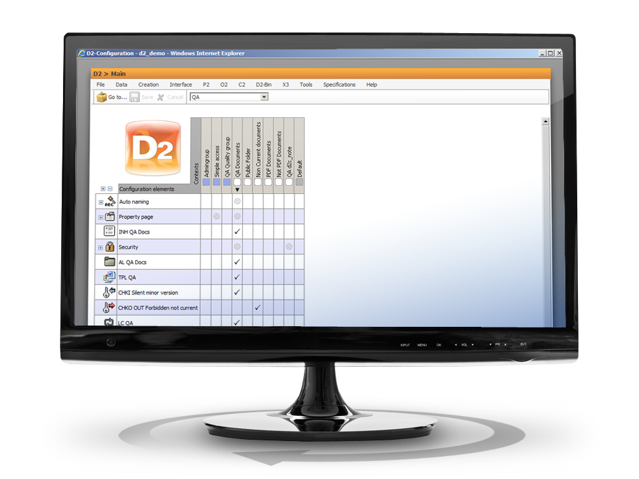
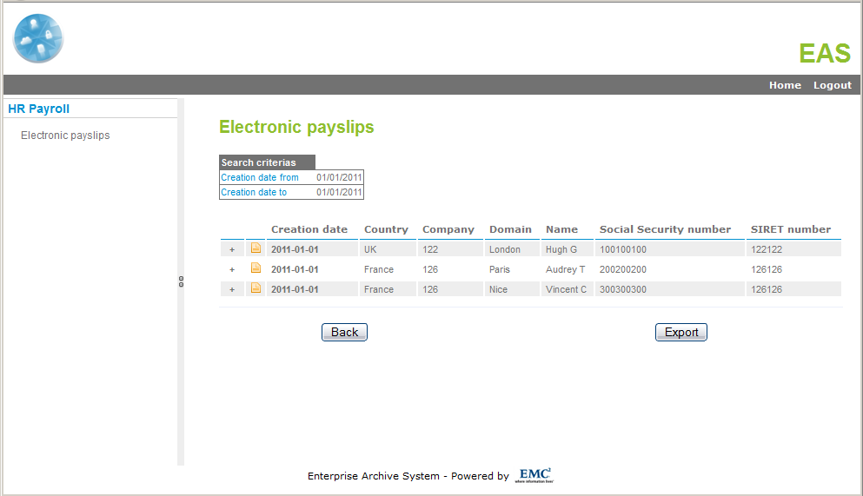
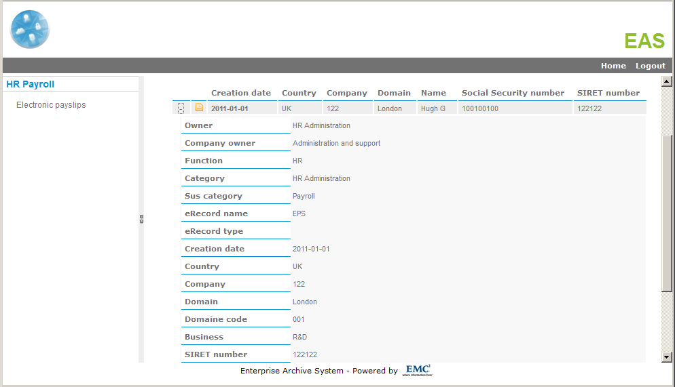
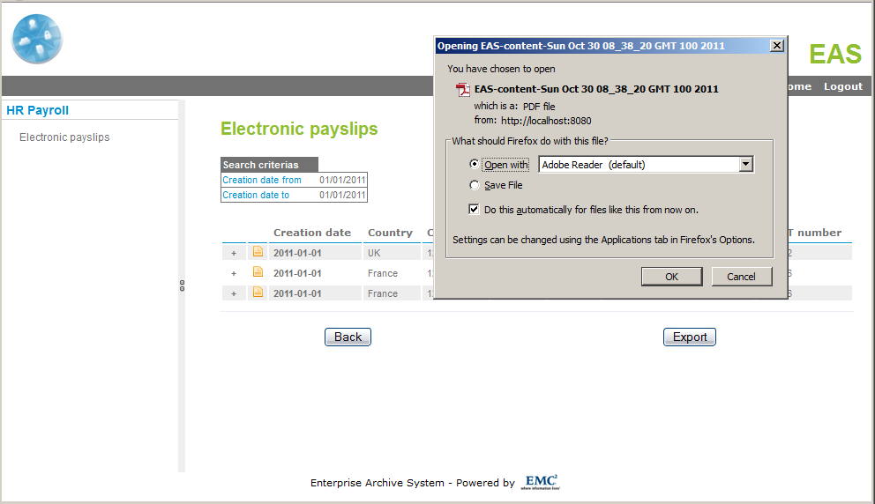
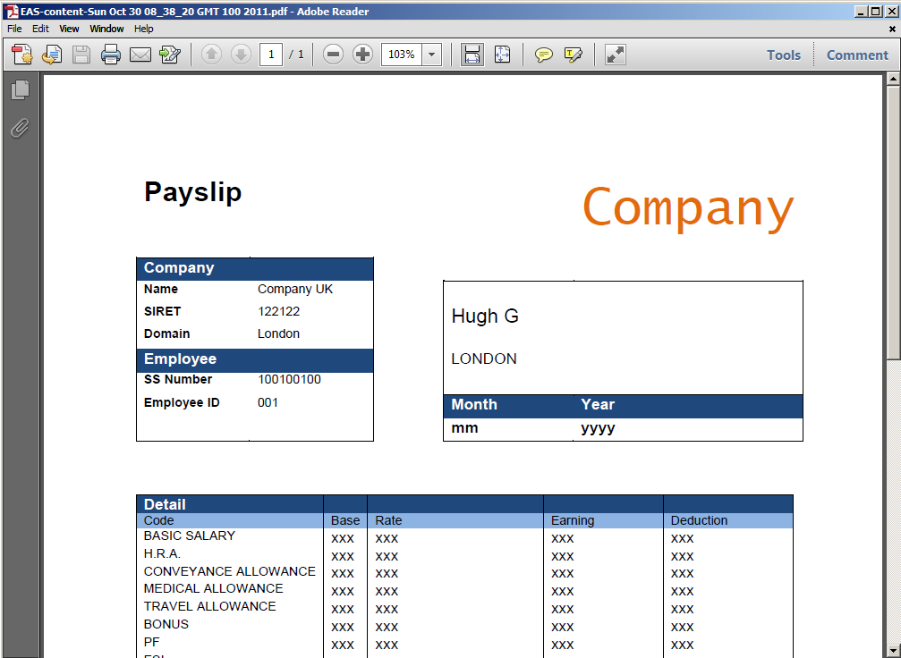

DEMO: Data Access
Market Overview
Product Description
Identify Opportunities
ACCESS DEMO
Qualify Opportunities
Competitive Differentiators
Position the EMC Solution
Proof Points
Additional Resources
© Copyright 2012 EMC Corporation. All rights reserved.
17

Slide 18
How InfoArchive Addresses the Cost Challenge
Market Overview
Server Costs
InfoArchive moves data out of the operational systems
So fewer servers are needed
License Costs
And fewer DBMS Licenses are needed
Less information in the operational systems means faster, easier backups, restores, and upgrades
Storage Costs
InfoArchive automatically moves the data to the right type of storage based on business policy
Commonly accessed data is kept in primary storage, which is faster
Other data is kept in secondary storage, which is less expensive
In addition, data is compressed, reducing the volume by 90%
And with Centera, data is replicated so no backups are needed for archived data
Product Description
Identify Opportunities
Qualify Opportunities
Competitive Differentiators
Position the EMC Solution
Proof Points
Additional Resources

Slide 19












How InfoArchive Addresses the Compliance Challenge
Market Overview
3
Product Description
Compliance Complexity
2
Identify Opportunities
1
Solution
Qualify Opportunities
Competitive Differentiators
Audit
Audit
Audit
Security
Security
Security
Position the EMC Solution
Retention
Retention
Retention
Immutable
Immutable
Proof Points
Timestamp
Timestamp
Additional Resources
E-Signature

Slide 20
How InfoArchive Addresses the Decommissioning Challenge
App Decommissioning is just a special kind of archiving
Step 1. Ingest all required data into the Unified Archive
Step 2. Verify the archived data is what you need
Step 3. Remove the source system from service
Step 4. Free up storage and servers and stop paying for support
Market Overview
Product Description
Identify Opportunities
Qualify Opportunities
Competitive Differentiators
INACTIVE DATA
Position the EMC Solution
OPERATIONAL SYSTEM
Proof Points
UNSTRUCTURED CONTENT
Additional Resources

Slide 21
S a l e s T r a i n i n g
IDENTIFY OPPORTUNITIES
This Section Will Cover:
The Buying Audience
Discovery Questions
Competitive Differentiation and Justification

Slide 22
Target Markets
Market Overview
Pharma
Financial
Services
Product Description
Sanofi
GSK
Societe Generale
Credit Agricole
Identify Opportunities
Manu-
facturing
Public
Sector
Qualify
Opportunities
Compliance Needs
STMicroelelectronics
Nokia
Legend
Ministry of Finances
Swedish Police
Primary
Target
Competitive Differentiators
Energy/
Utilities
Secondary
Target
Position the EMC Solution
GDF Suez
BP
Telco
Proof Points
Additional Resources
Data Volumes

Slide 23
Target Accounts
Account Profile
Market Overview
Industry | Financial Services Pharmaceuticals Government Agencies Utilities and Energy Telecommunications
Size | Large enterprises- 5000+ employees
Situational Factors | High volume of transactional data High Compliance Requirements Regulated industries High legal risk exposure High HR or financial scrutiny Old or obsolete systems that are no longer active Applications suffering from performance problems Mergers & Acquisitions
Product Description
Identify Opportunities
Qualify
Opportunities
Competitive Differentiators
Position the EMC Solution
Proof Points
Additional Resources

Slide 24
Target Accounts
Account Profile
Market Overview
Industry | Financial Services Pharmaceuticals Government Agencies Utilities and Energy Telecommunications
Size | Large enterprises- 5000+ employees
Situational Factors | High volume of transactional data High Compliance Requirements Regulated industries High legal risk exposure High HR or financial scrutiny Old or obsolete systems that are no longer active Applications suffering from performance problems Mergers & Acquisitions
IT Environment | Multiple data-intensive applications (terabytes of data) 20% annual structured data growth (or more) Thousands of documents (unstructured content) per day Mainframes and ZOS environments
Technology Installed | EMC storage solution customers EMC Documentum
Product Description
Identify Opportunities
Qualify
Opportunities
Competitive Differentiators
Position the EMC Solution
Proof Points
Additional Resources

Slide 25
Competitive Overview
IBM Optim
Market Overview
Structured Data
HP
Product Description
INFA
InfoArchive
Identify Opportunities
Qualify Opportunities
IBM FileNet
ASG Mobius
Competitive Differentiators
Unstructured Data
OpenText
IBM CMOD
Position the EMC Solution
Proof Points
Data Volumes
Additional Resources
InfoArchive is the only solution based on open standards that archives
Structured and Unstructured content at scale

Slide 26
Landmines (Avoiding & Planting)
Objection | Response
EMC does not provide ETL capabilities (as IBM, HP and Informatica do). | We allow the customer to utilize their own ETL tool, which they are probably already have (and are more comfortable with)
I want to open the archived data in the source application (which our competitors can do). | 1: Our competitors maintain this data in a proprietary DB. We maintain the data in a non-proprietary format. 2: Sometimes there is no real need for retrieving this data in the source application since users will retrieve it in a portal 3: You can modify your source application to invoke the InfoArchive web services.
I already archive. | Ask these questions: Is the archiving system only for a single application? Does it archive content as well as database data? Are you using multiple archiving systems (expensive) Does your archiving system meet compliance requirements?
Market Overview
Product Description
Identify Opportunities
Qualify Opportunities
Competitive Differentiators
Position the EMC Solution
Proof Points
Additional Resources

Slide 27
Landmines (Avoiding & Planting)
Objection | Response
Why can’t I just do backup: why do I need archiving? | Unlike archiving, backups are temporary measures and are not easy for users to access. They are generally overwritten and don’t meet compliance requirements for retention and immutability.
InfoArchive does not provide analytical capabilities for the archived data | Using an ETL tool you can load the desired data into a BI tool or data warehouse and do whatever analysis you want
InfoArchive is pre-integrated with Centera but what if I don’t have Centera? | With minor customization, InfoArchive can be integrated with any Content Addressable Storage (CAS).
Market Overview
Product Description
Identify Opportunities
Qualify Opportunities
Competitive Differentiators
Position the EMC Solution
Proof Points
Additional Resources

Slide 28
S a l e s T r a i n i n g
POSITIONING THE EMC SOLUTION
This Section Will Cover:
Value Proposition and Positioning
Customer Use Cases
Industry and Analyst Quotes
Guidelines and Resources

Slide 29
Value Proposition
Market Overview
Product Description
Unlike ANY other archiving solution,
InfoArchive is a unified approach
to application archiving
that reduces costs, satisfies compliance regulations, and enables application decommissioning in an versatile and scalable enterprise solution
Identify Opportunities
Qualify Opportunities
Competitive Differentiators
Position the EMC Solution
Proof Points
Additional Resources

Slide 30
Sources of Value
Market Overview
Business Value | Sources of value, validation or proof
Compliance | Data entered in as “immutable” Retention Encryption, Digital Signatures Future proof – non-proprietary data format
User Productivity | Improved performance of business applications
Unified view of Application Data | All archived information (structured and unstructured) from all applications is accessible from a single source
Product Description
Identify Opportunities
Qualify Opportunities
Competitive Differentiators
Position the EMC Solution
Proof Points
Additional Resources

Slide 31
Sources of Value
Market Overview
IT Value | Sources of value, validation or proof
Reduce cost CapEx OpEx | Reduce number of servers by moving data from mainline application to less expensive storage Reduce resources required for application and storage administration and maintenance
Rapid time to value | High-volume ingestion accelerates archiving
Scalability | Store 100’s of billions of records
Versatility | Easy to configure to meet business requirements Ease of administration
Product Description
Identify Opportunities
Qualify Opportunities
Competitive Differentiators
Position the EMC Solution
Proof Points
Additional Resources

Slide 32
The Three Components of InfoArchive Pricing
Market Overview
InfoArchive IP
Flat rate of $200K
Software delivered in consulting engagement
Product Description
Consulting
Services
Variable amount, depending on project scope
Identify Opportunities
Qualify Opportunities
Recurring charge, based on the archiving done
InfoArchive meters the amount of archiving
Tiered pricing (rates decrease as volume increases)
Volume
Pricing
Competitive Differentiators
Position the EMC Solution
Example:
Proof Points
Additional Resources

Slide 33
How InfoArchive is Delivered
Phase 4 Production
Phase 3 Acceptance
Phase 2 Integration
Phase 1 Development
Market Overview
2.5 FTE’s 4-6 month engagement
Product Description
IIG
Identify Opportunities
Qualify Opportunities
Competitive Differentiators
Partner
Position the EMC Solution
VMWare prototype
Design workshops
Integration with business applications
Further customization
Client testing
Training
Deployment
Proof Points
Additional Resources
IIG leads the engagement in the beginning but
assists the partner in the subsequent phases
Notes:
Let’s talk for a moment about how the solution is actually delivered. As we mentioned, InfoArchive is a Consulting Solution, so IIG Consulting will play a pivotal role. Let’s assume that the IIG project is based on Time and Materials (rather than fixed fee). Then the engagement will be structured as you see.
PARTNERING
IIG Consulting can deliver the complete InfoArchive solution. But more often we work with a partner – either EMCC or an SI chosen by the client. A typical engagement is about 6 months long.
DEVELOPMENT PHASE: BUIDING A PROTOTYPE
IIG Consulting will work with the client to archive a single application. This usually involves a number of design workshops with the client to flesh out the requirements. To save time and reduce complexity, the prototype is created as a VMWare image.
LATER PHASES
In the later phases of the project, the partner takes the lead and IIG Consulting provides assistance. In these phases we extend the prototype to include other applications, perform any necessary customization, test the application, and deploy the solution into the production environment.

Slide 34

Customer Examples & Use Cases
Market Overview
Initial Requirements
Compliance: Need to archive VAT invoices (print streams)
Online Business: Archive customer monthly statements so they can be put online
Cost Reduction: Archive documents produced by 15 different systems
Availability: Make this information available to all authorized internal and external users
Product Description
Identify Opportunities
Qualify Opportunities
Competitive Differentiators
Position the EMC Solution
Proof Points
Additional Resources

Slide 35
Customer Examples & Use Cases
Market Overview
One year later, InfoArchive was archiving 67 applications with a mix of structured and unstructured data
Structured Data
Total: 20+ Billion data records archived
Daily: 16 million archived; 1,000 retrievals
Unstructured Data
Total : 670+ Million documents archived
Monthly: 10 million archived; 600,000 retrievals
Performance
Average search time for data = 2.5 sec
Average retrieval time for documents 0.5 sec
Product Description
Identify Opportunities
Qualify Opportunities
Competitive Differentiators
Position the EMC Solution
Proof Points
Additional Resources

Slide 36
Customer Examples & Use Cases
Market Overview
Additional Savings
They were able to stop using paper for archiving
They were able to stop using microfiche
Mobius archive was decommissioned
Log Archive system was decommissioned
Product Description
Identify Opportunities
Qualify Opportunities
Competitive Differentiators
Position the EMC Solution
Proof Points
Additional Resources

Slide 37
Industry Quotes
Market Overview
Archived information differs from backup data in that backup data is typically a temporary copy of a data set that is ultimately overwritten, while archived information is moved—not copied—from one system to another and is often a permanent copy of a record or data set that is stored without alteration or deletion for a specified period of time. [ESG]
The long-term retention and management of electronic information that has been purposefully retained to satisfy records management, data management, regulatory compliance, or litigation support requirements. [ESG]
60-80% of data in operational applications is inactive [Gartner]
Product Description
Identify Opportunities
Qualify Opportunities
Competitive Differentiators
Position the EMC Solution
Proof Points
Additional Resources

Slide 38
Additional Resources
Internal Resources & Links
Partner Resources & Links
Market Overview
Customer Presentation (“Blue Ribbon”)
Solution Overview
FAQ
Case Studies
Competitive Analysis
Cost Savings Analysis “ROI”)
Thursday Live (Recording)
Sample SOW
InfoArchive Pricing
InfoArchive Technical Overview
TBD
Product Description
Identify Opportunities
Qualify Opportunities
Competitive Differentiators
Position the EMC Solution
Proof Points
Additional Resources

Slide 39
Course Summary
During this course, you have learned to:
Describe EMC InfoArchive, its capabilities, and differentiators
Describe how the InfoArchive addresses customer challenges
Identify an InfoArchive opportunity
Qualify the opportunity and handle competitive situations
Position InfoArchive in the customer environment

Slide 40

Thank You
2011 Sales Accreditation Training
Please note:
It may take up to 24 hours for your transcript to be updated and reflect that you have successfully completed this course.
If after 24 hours your transcript is not updated, please send an e-mail to EdServices@emc.com describing your issue.
Please include:
Badge Number
Course Title
Issue
Notes:
Take a moment to complete this assessment which covers the key objectives of this training course. You will receive credit for this sales course in your transcript.
PLEASE NOTE:
It may take up to 24 hours for your transcript to be updated and reflect that you have successfully completed this course.
If after 24 hours your transcript is not updated, please send an email to EdServices@emc.com describing your issue.

Slide 41

Click here to provide feedback
Notes:
Congratulations on successfully completing this sales training course. Please take this opportunity to provide us with your feedback on how we can continue to improve EMC’s Sales Education program. Thank you.

